Slide 1


1
DYNAMIC CAUSAL MODELLING OF COVID-19
Abstract: This technical report describes a dynamic causal model of the spread of coronavirus through a population. The model is based upon ensemble or population dynamics that generate outcomes, like new cases and deaths over time. The purpose of this model is to quantify the uncertainty that attends predictions of relevant outcomes. By assuming suitable conditional dependencies, one can model the effects of interventions (e.g., social distancing) and differences among populations (e.g., herd immunity) to predict what might happen in different circumstances. Technically, this model leverages state-of-the-art variational (Bayesian) model inversion and comparison procedures, which have been developed to characterise the responses of neuronal ensembles to perturbations. Here, this modelling is applied to epidemiological populations—to illustrate the kind of inferences that are supported and how the model per se can be optimised given timeseries data. Although the purpose of this paper is to describe a modelling protocol, the results provide some interesting perspectives on the current pandemic; for example, the nonlinear effects of herd immunity that speak to a self-organised mitigation process.
Key words: coronavirus; epidemiology; compartmental models; dynamic causal modelling; variational; Bayesian

Slide 2
Scientific Advisory Group for Emergencies (SAGE): Coronavirus (COVID-19) response
The Scientific Advisory Group for Emergencies (SAGE) provides scientific and technical advice to support government decision makers during emergencies.
Role
SAGE is responsible for ensuring that timely and coordinated scientific advice is made available to decision makers to support UK cross-government decisions in the Cabinet Office Briefing Room (COBR). The advice provided by SAGE does not represent official government policy.
Expert groups
SAGE relies on external science advice and on advice from expert groups. During COVID-19 this includes the:
New and Emerging Respiratory Virus Threats Advisory Group (NERVTAG)
Scientific Pandemic Influenza Group on Modelling (SPI-M) (Department for Health and Social Care)
Independent Scientific Pandemic Influenza Group on Behaviours (SPI-B)
These groups consider the scientific evidence and feed in their consensus conclusions to SAGE.

Slide 3
Introduction
The generative model
Transition probabilities and priors
Initial conditions
The likelihood model
Bayesian model comparison
Parametric empirical Bayes and hierarchical models
Dynamic causal modelling of a single country
Predictive Validity
Conclusions
Outstanding issues
Software note

Slide 4


Generative or forward models

Slide 5
An SEIR model
(2) infection
Susceptible
Infected
Immune
Infectious
(1) location
(3) clinical
CCU: critical care unit
Home
Work
CCU
Morgue
asymptomatic
Symptoms
ARDS
Deceased
(4) testing
Untested
Waiting
Positive
Negative
ARDS: Acute Respiratory Distress Syndrome
Key data structure:
Probability structure over these factors.
Is the data structure a true joint probability distribution over all factors?
Death
Recorded death
Positive
Test for coronavirus

Slide 6
(baseline)
Elsewhere much smaller
looks large
Where am I?
steepness of decline
Home
CCU
higher
Wrk
Mo
Home
0
1
Work
What about P_infectious?
CCU
Morgue
1
the threshold/bias
higher
0
(1) location
Home
Work
CCU
Morgue

Slide 7
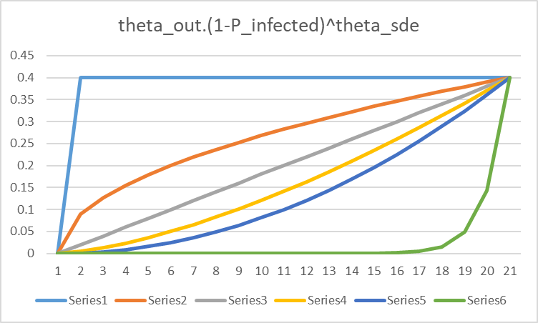
Note, for the same step size, the curve changes much more for theta_sde’s above 1 than below 1.
theta_sde=0.00001
theta_sde=0.5
theta_sde=1
theta_sde=2
theta_sde=1.5
theta_sde=20
0
1

Slide 8
Am I infected?
(2) infection
susceptible
infectious
infected
immune
Susceptible
Infected
Immune
Infectious
susceptible
infected
infectious
immune
Probability of staying uninfected when come into contact with somebody
Independence assumption here,
i.e. if meet a person who is contagious, does not increase prob will meet another.
can dead bodies infect?
prob of staying infected, but no more
prob of staying infectious

Slide 9
Am I ill?
(3) clinical
asymptomatic
Symptoms
ARDS
Deceased
Death
Recorded death
Two conditional dependencies with other factors here: from infection and home

Slide 10
Have I been tested?
rate at which tests can be performed
proportion waiting
(4) testing
Untested
Waiting
Positive
Negative
threshold/ bias of decreasing sigmoidal, determined by testing capacity per capita
If have symptoms (infected or infectious) prob selected for a test
untested
negative
waiting
positive
untested
Positive
Test for coronavirus
waiting
positive
negative
prob stay waiting, due to delays in getting test results.
Assumes test is 100% reliable, no misses or false positives

Slide 11
Initial conditions
Kronecker product an operator on matrices
Thought, specialisation to vectors was the cross product, which would create a very large matrix, perhaps the 4-dimensional joint???

Slide 12
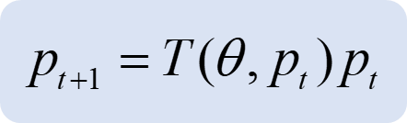
Model parameters: the unknowns
Number | Mean | Variance | Description
1 | 1 | 1/4 | Number of initial cases
2 | 1 | 1/16 | Effective population size (millions)
3 | 10⁻⁶ | 0 | Herd immunity (proportion)
Location
4 | 1/3 | 1/64 | Pr(work | home): probability of going out
5 | 1 | 1/64 | Social distancing exponent
6 | 128/100000 | 1/64 | CCU capacity threshold (per capita)
Infection
7 | 3 | 1/64 | Effective number of contacts: home
8 | 48 | 1/64 | Effective number of contacts: work
9 | 1/4 | 1/64 | Pr(contagion | contact)
10 | 5 | 1/64 | Infected (pre-contagious) period (days)
11 | 3 | 1/64 | Infectious (contagious) period (days)
Clinical
12 | 1/3 | 1/64 | Pr(symptoms | infected)
13 | 1/100 | 1/64 | Pr(ARDS | symptomatic)
14 | 5 | 1/64 | symptomatic period (days)
15 | 12 | 1/64 | acute RDS period (days)
16 | 1/3 | 1/64 | Pr(fatality | CCU)
17 | 1/16 | 1/64 | Pr(survival | home)
Testing
18 | 500/100000 | 1/64 | Threshold: testing capacity (per capita)
19 | 1/100 | 1/64 | Rate: testing capacity (%)
20 | 2 | 1/64 | Delay: testing capacity (days)
21 | 1/8 | 1/64 | Relative Pr(tested | uninfected)
???
Priors: means; and variances.
state of SEIR model at time t: a big joint prob dist with a dimension per factor, I THINK!
operator to progress system by one time step.
Not completely sure how is generated from the matrices have seen, Kronecker product of some form??
Sources (Huang et al., 2020; Mizumoto and Chowell, 2020; Russell et al., 2020; Verity et al., 2020; Wang et al., 2020a) and:
https://www.statista.com/chart/21105/number-of-critical-care-beds-per-100000-inhabitants/
https://www.gov.uk/guidance/coronavirus-covid-19-information-for-the-public
http://www.imperial.ac.uk/mrc-global-infectious-disease-analysis/covid-19/
How influential are priors?

Slide 13
Model inversion or fitting
data/ observations are counts, e.g. no. deceased;
model as binomial, e.g. no. of deceased in population of size n, given prob. π.
since n is large, approx. with Gaussian.
variance stabilisation – variance becomes unity. [may have stabilised for Poisson, not Binomial????]
Large number assumptions
Likelihood model
calc prob. of each time point and multiply them down time-series. Presumably auto-correlations in time-series handled elsewhere??
not sure about 10⁶ for pop. size;
change in deceased (4 is deceased);
prob. of deceased at t+1;
Variational Bayes
(Laplace)
posterior is a multivariate Gaussian, with a covariance component C. Think about dependencies between params.
exact calc of posterior intractable.
approximate posterior is similarly configured.
seeking approx. posterior that maximises negative??? free energy.. [Ask Theophile.]
variational free energy;
trading off accuracy and complexity;
accuracy: “matching” approx. posterior to likelihood;
complexity: how different approx. posterior is to prior;
Evidence Lower Bound (ELBO).

Slide 14
The data 1
function data = DATA_COVID_JHU
% Data retrieval function for COVID modelling
% FORMAT data = DATA_COVID_JHU
%
% This auxiliary routine retrieves data from comma separated data files
% that can be downloaded from:
% https://github.com/CSSEGISandData/COVID-19/
%
% time_series_covid19_confirmed_global.csv
% time_series_covid19_deaths_global.csv
% …

Slide 15
The data 2
Interesting gap in spread.
Each point a country, placed to indicate time since start of outbreak.
Each point a country, placed to indicate number of deaths, by position according to duration plot.
italy
china
deaths in 48 days, by population size
Total cases by cumulative deaths – strong correlation.
Countries with best health systems – Canada, Germany, perhaps Israel??

Slide 16
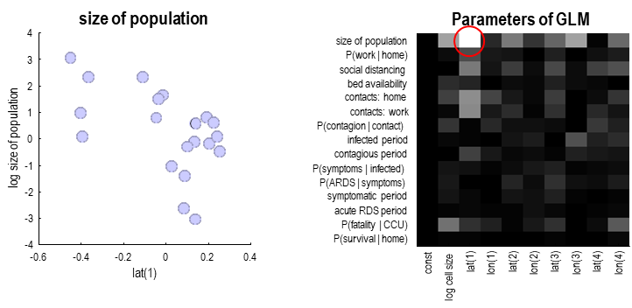
Parametric empirical Bayes and between-country effects
Hierarchical GLM
Doing statistical inference across countries, on parameters derived from fitting model.
1st level: i ranges over countries
2nd level: across countries
hyper-priors
Size of at-risk population correlates with latitude (negatively)
variation across latitude and longitude on different scales

Slide 17
Bayesian model reduction to eliminate redundant parameters
log-posterior
10
-3
model posterior
24
7
23.8
6
Fit full (over-parameterised) model then assess evidence for 256 variants, with different parameters deleted.
y
23.6
t
i
y
l
i
t
b
i
5
l
a
i
b
b
o
23.4
a
r
b
p
o
-
r
g
p
4
o
l
23.2
23
3
22.8
0
50
100
150
200
250
300
2
0
50
100
150
200
250
300
model
model
MAP (full)
MAP (reduced)
MAP: maximum a posterior probability – maximum likelihood estimate with priors
4
4
2
2
0
0
MAP estimates in blue;
credibility intervals in pink.
-2
-2
-4
-4
-6
-6
Can prune many parameters
-8
0
50
100
150
-8
0
50
100
150

Slide 18
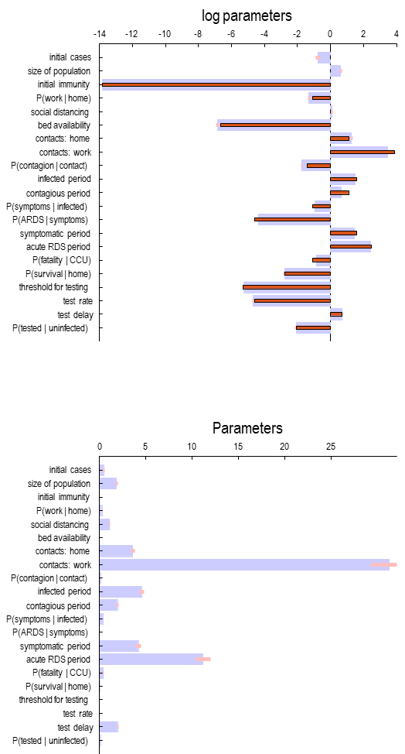
Bayesian parameter averages
Log parameters
red bars are the prior settings of the parameters
social distancing very small
Scale parameters

Slide 19
Country specific differences

Slide 20
Estimates for the United Kingdom
parameter | Mean | Units | Upper | Lower
initial cases | 0.33 |  | 0.19 | 0.57
size of population | 2.49 | Million | 1.99 | 3.11
P(work | home) | 17 | % | 12 | 23
social distancing | 1.60 |  | 1.159 | 2.2
contacts: home | 7.01 |  | 5.49 | 8.95
contacts: work | 16.02 |  | 12.12 | 21.19
P(contagion | contact) | 19 | % | 15 | 25
infected period | 6.44 | Days | 4.87 | 8.51
contagious period | 2.93 | Days | 2.15 | 3.99
P(symptoms | infected) | 47 | % | 34 | 65
P(ARDS | symptoms) | 1.70 | % | 1.31 | 2.20
symptomatic period | 3.45 | Days | 2.55 | 4.68
acute RDS period | 10.89 | Days | 8.07 | 14.70
P(fatality | CCU) | 48 | % | 39 | 60
P(survival | home) | 6.36 | % | 4.56 | 8.87
test delay | 2.02 | Days | 1.668 | 2.45
P(tested | uninfected) | 0.12 | % | 10 | 15

Slide 21
Corresponding predictions
Influenza deaths – red dashed.
Black dots – data fitted to.
A couple of poor fitting points.

Slide 22
And latent states
Immunity to 100% here.
Latent, i.e. unobserved variables
People still testing positive, even though nobody left who is infected?

Slide 23
Sensitivity analysis
Contribution to cumulative deaths.
First-order
neg corr with deaths
positive correlation with deaths
Second order
In fact
1
2

Slide 24
The effect of social distancing
Inferred social distancing exponent
Vary social distancing exponent
Not all social distancing exponents generate 100% herd immunity.

Slide 25
The effect of initial immunity
Vary levels of initial immunity.

Slide 26
Basic reproduction number
Effective reproduction rate

Slide 27
Predictive validity (Italy)
Red points – out-of-sample test.

Slide 28
A narrative for London
“Based on current data, reports of new cases are estimated to peak on April 5, followed by an expected peak in death rates around April 10 (Good Friday). At this time critical care unit occupancy should peak, approaching—but not expected to exceed—capacity based on current predictions and resource availability. At the peak of death rates, the proportion of people infected is expected to be about 32%, which should then be surpassed by the proportion of people (in London) who are immune at this time. Improvements should be observed by May 8, shortly after the May bank holiday, that may allow social distancing to be relaxed, and herd immunity should have risen to about 80%. At this time, about 12% of London's population will have been tested and just under half of those tested will be positive. By June 12, death rates should have fallen to very low levels with over 90% of people being immune and social distancing will no longer be a feature of daily life.”

Slide 29
Outstanding issues
The generative model—at both the first and second level—needs to be explored more thoroughly. At the first level, this may entail the addition of other factors; for example, splitting the population into age groups or different classes of clinical vulnerability. Procedurally, this should be fairly simple, by specifying the DCM parameters for each age group (or cohort) separately and precluding transitions between age groups (or cohorts). One could also consider increasing the graining of states within each factor. For example, making a more careful distinction between being in and not in critical care (e.g., being in self-isolation, being in a hospital, community care home, rural or urban location and so on). At the between city or country level, the parameters of the general linear model could be easily extended to include a host of demographic and geographic independent variables. Finally, it would be fairly straightforward to increase the graining of outcomes, using regional timeseries, as opposed to country timeseries (these data are currently available from: https://github.com/CSSEGISandData/COVID-19).
Another plausible extension to the hierarchical model is to include previous outbreaks of MERS and SARS (Middle East and Severe Acute Respiratory Syndrome, respectively) in the model. This would entail supplementing the timeseries with historical (i.e., legacy) data and replicating the general linear model for each type of virus. In effect, this would place empirical priors or constraints on any parameter that shares characteristics with MERS-CoV and SARS-CoV.
In terms of the model parameters—as opposed to model structure—more precise knowledge about the underlying causes of an epidemic will necessarily produce more precise posteriors. In other words, more information about the DCM parameters can be installed through adjusting the prior expectations and variances. The utility of these adjustments would then be assessed in terms of model evidence. This may be particularly relevant as reliable data about bed occupancy, proportion of people recovered, etc becomes available.
A key aspect of the generative model used in this technical note is that it precludes any exogenous interventions of a strategic sort. In other words, the things that matter are built into the model and estimated as latent causes. However, prior knowledge about fluctuating factors, such as closing schools or limiting international air flights, could be entered by conditioning the DCM parameters on exogenous inputs. Again, these conditions would only be licensed by an increase in model evidence (i.e., through comparing the evidence for models with and without some structured intervention). This may be especially important when it comes to modelling future interventions, for example, a ‘sawtooth’ social distancing protocol. A simple example of this kind of extension would be including a time dependent increase in the capacity for testing: at present, constraints on testing rates are assumed to be constant.

Slide 30
Software note
The figures in this technical note can be reproduced using annotated (MATLAB) code that is available as part of the free and open source academic software SPM (https://www.fil.ion.ucl.ac.uk/spm/). This software package has a relatively high degree of validation; being used for the past 25 years by over 5000 scientists in the neurosciences. The routines are called by a demonstration script that can be invoked by typing >> DEM_COVID. At the time of writing, these routines are undergoing software validation in our internal source version control system - that will be released in the next public release of SPM (and via GitHub at https://github.com/spm/).
Thank you – to lots of people

Slide 31

log parameters
-14
-12
-10
-8
-6
-4
-2
0
2
4
initial cases
size of population
initial immunity
size of population
Parameters of GLM
P(work | home)
4
size of population
social distancing
P(work | home)
bed availability
3
social distancing
contacts: home
n
2
bed availability
contacts: work
o
i
t
contacts: home
P(contagion | contact)
a
l
u
1
contacts: work
infected period
p
o
P(contagion | contact)
p
contagious period
f
0
infected period
o
P(symptoms | infected)
e
z
contagious period
i
P(ARDS | symptoms)
s
-1
P(symptoms | infected)
g
o
symptomatic period
l
-2
P(ARDS | symptoms)
acute RDS period
symptomatic period
P(fatality | CCU)
-3
acute RDS period
P(survival | home)
P(fatality | CCU)
threshold for testing
-4
P(survival | home)
t
e
)
)
)
)
)
)
)
)
s
z
1
1
2
2
3
3
4
4
test rate
-0.6
-0.4
-0.2
0
0.2
0.4
n
i
(
(
(
(
(
(
(
(
o
s
t
n
t
n
t
n
t
n
a
o
a
o
a
o
a
o
c
l
l
l
l
l
l
l
l
l
test delay
lat(1)
l
e
c
P(tested | uninfected)
g
o
l
Parameters
0
5
10
15
20
25
initial cases
size of population
initial immunity
P(work | home)
social distancing
bed availability
contacts: home
contacts: work
P(contagion | contact)
infected period
contagious period
P(symptoms | infected)
P(ARDS | symptoms)
symptomatic period
acute RDS period
P(fatality | CCU)
P(survival | home)
threshold for testing
test rate
test delay
P(tested | uninfected)

